Slide 1

Department of Information Science
Tracking Research Focus on Autonomous Driving Over Time
- Teja Mandaloju
Hema Reddy Yanala
Lavanya Nidamanuri
Vijaya Kumari
Kavya Likitha
Chaitanya Priyanka
Instructor: Yuhan Zhou
Group No. 4
Dec 04, 2024

Slide 2
Table of Contents:
INTRODUCTION
PROBLEM STATEMENT
RELATED WORK
METHODOLOGY
RESULTS
CHALLENGES & LIMITATIONS
CONCLUSION & FUTURE WORK
REFERENCES

Slide 3


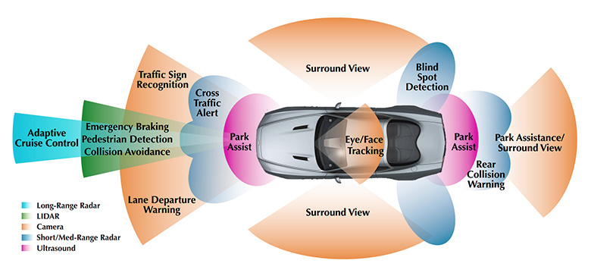
Introduction
Autonomous driving technology has been a focus of research for decades.
Early breakthroughs in AI and robotics led to the first prototypes.
Progress in sensors, machine learning, and computer vision has brought self-driving closer to reality.
Challenges persist in safety, regulation, and public acceptance.
The research landscape reflects the complexity and evolving scope of this technology.

Slide 4
Introduction (Cont.)
Scope:
This study focuses on tracking the evolution of research in autonomous driving through the analysis of academic literature
It aims to bridge gap between historical research patterns and the future direction of autonomous vehicle technology
Objectives:
To collect & preprocess academic publications on autonomous driving from multiple reputable sources
To analyze dominant research themes using NLP techniques
To visualize the progression of these themes over time, providing actionable insights for researchers and industry stakeholders

Slide 5
Problem Statement
The rapid advancements in autonomous driving technologies have led to a proliferation of research, making it challenging to track evolving themes and identify influential factors. This project addresses the need for a structured analysis to uncover trends, patterns, and gaps in the literature, enabling a deeper understanding of the field’s trajectory.
Research Questions:
1. What are the dominant research themes and trends in autonomous driving research?
2. How have these themes shifted over time?
3. What external factors (e.g., technological breakthroughs, regulations) have influenced these shifts?

Slide 6
Related Work
Multimodal Data Integration:
MLLMs enhance perception, motion planning, and control by combining inputs like sight, hearing, maps, and traffic reports, but face challenges with rare scenarios, bad weather, and dynamic road conditions. (Qingyang Zhang et al. - "Multimodal Fusion on Low-quality Data: A Comprehensive Survey“)
Advances in Testing & Object Detection:
Key datasets (KITTI, Oxford RobotCar, Cityscapes) and simulators (AirSim, CARLA) ensure safe pre-deployment testing, while 3D object detection integrates sensors (LiDAR, radar, cameras) to overcome occlusion and variable conditions. (Alexander G. Schwing et al.)
Future Outlook & Impact:
Focus on robust multimodal fusion for low-quality data, scalable algorithms for sensor data, and real-time detection to ensure safety in complex, dynamic scenarios. (Henrik I. Christensen et al.)
Notes:
Mention papers for this one and authors and titles

Slide 7
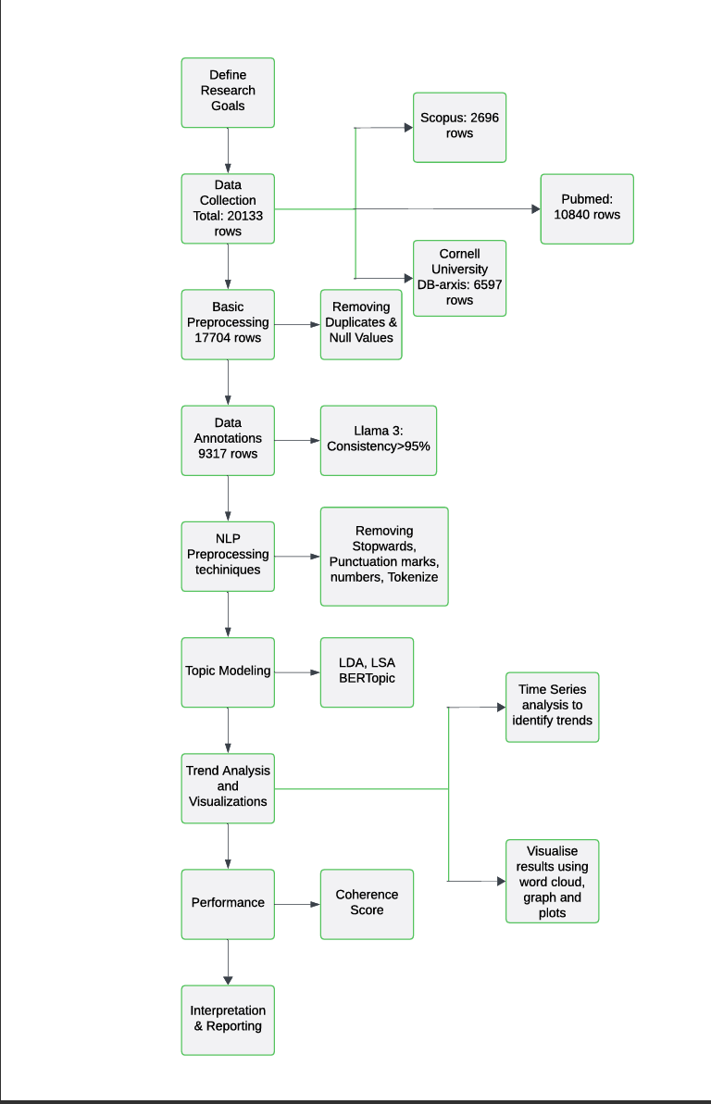
Methodology
1. Flow chart of Workflow

Slide 8
Methodology (Cont.)
Data Collection:
Sources:
Scopus (2,696 rows): Collected research papers related to Autonomous Vehicles (AVs) from this extensive academic database, ensuring access to high-quality, peer-reviewed content.
PubMed (10,840 rows): Focused on AV-related research in bioinformatics domain highlighting safety and ethical concerns in medical applications of AVs.
DB-arXiv (6,597 rows): Extracted preprints and cutting-edge research papers to incorporate the latest trends and methodologies in the field.
Total Rows:
Initial dataset comprised 20,133 rows, providing a robust foundation for subsequent analyses.

Slide 9
Methodology (Cont.)
Preprocessing:
Duplicate and Null Value Removal:
Eliminated duplicate entries and rows with missing critical data such as titles, abstracts, or publication years, reducing the dataset to 17,704 rows.
Ensured the dataset was clean and suitable for further NLP-based processing and analysis.
Data Annotation:
Annotation Process:
Utilized Llama 3 to assess the relevance of each paper. The model categorized papers as either relevant (1) or irrelevant (0) based on predefined criteria related to AV research.
Validation and Consistency:
Conducted multiple validation runs (e.g., 3 and 5 cycles) to ensure reliability of the annotations.
Achieved >95% consistency, indicating the model's high accuracy and reliability in annotating the dataset.

Slide 10
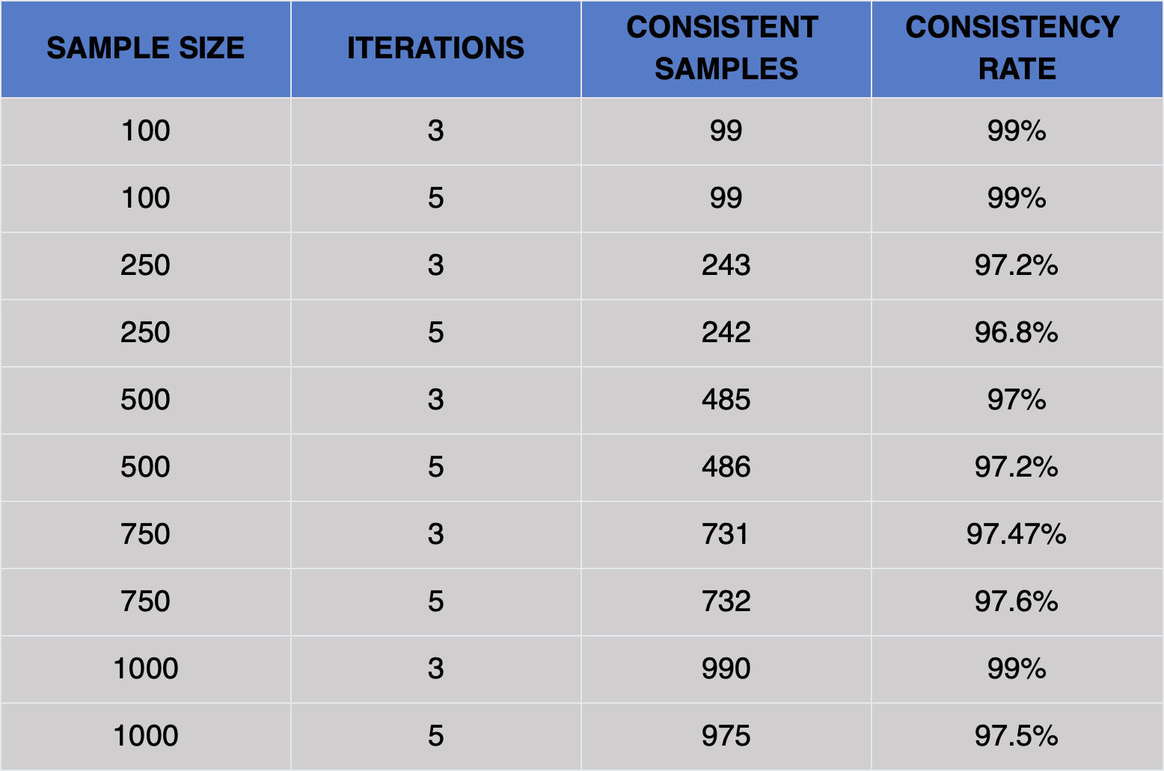
Methodology (Cont.)
Out of the preprocessed dataset, 9,317 rows were marked as relevant, forming the final dataset for analysis.
2. Table showing consistency of Llama3

Slide 11
Methodology (Cont.)
NLP Preprocessing:
Stopword Removal: Removed common stopwords like "and," "the," and "of" to focus on meaningful keywords.
Tokenization: Split text into individual words or tokens for easier analysis.
Lemmatization: Standardized words to their root forms (e.g., "driving" → "drive"), ensuring consistency in textual representation.
Analysis:
Topic Modeling:
Applied three models to identify key research themes:
LDA (Latent Dirichlet Allocation): Used to classify abstracts into dominant topics based on word distributions.
LSA (Latent Semantic Analysis): Applied to uncover latent relationships between terms and documents.
BERTopic: Leveraged advanced transformer models for contextual topic generation.
Measured coherence scores to evaluate the quality of the topics generated by each model.

Slide 12
Methodology (Cont.)
Temporal Analysis:
Conducted temporal analysis to study the evolution of research topics over time.
Examined trends in publications to identify shifts in focus areas, such as a rise in studies on AV ethics and deployment post-2020.
Visualization:
Developed various visual representations to summarize findings:
Coherence Scores: Highlighted the reliability and interpretability of topics generated.
Topic Trends: Displayed temporal variations in research focus through line graphs.
Word Clouds: Illustrated the most frequent keywords for each dominant topic, providing an intuitive overview of the research landscape.

Slide 13
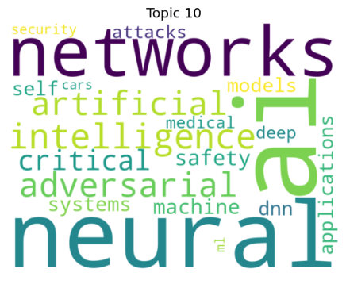
Results
The dataset, after rigorous preprocessing and annotation, provided a refined collection of 9,317 relevant rows from an initial pool of 20,133 rows. This curated dataset underwent comprehensive analysis, revealing significant research themes and trends in autonomous vehicle (AV) studies.
LDA effectively distributed words across multiple topics, enabling clearer distinctions in core research areas. Computer vision techniques in AVs," "regulations and safety," and "AI-driven traffic management systems."
3. Topics generated by LDA
Notes:
What Pic?

Slide 14
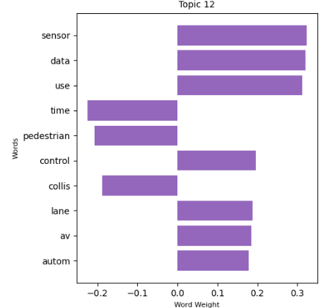
Results
LSA captured latent relationships between terms and documents but struggled with nuanced topic differentiation. Its reliance on matrix factorization without probabilistic context limited the interpretability of topics. Broad topics like "autonomous system frameworks" and "simulation environments.“
Leveraging transformer-based embeddings, BERTopic captured domain-specific terminology and nuanced trends, outperforming traditional models. Advanced topics like "ethical implications of AVs," "autonomous fleet management," and "hybrid models for AV decision-making.“LDA and BERTopic outperformed LSA, with BERTopic offering the best topic clarity and granularity.
4. Topics generated by LSA
Notes:
What Pic?

Slide 15
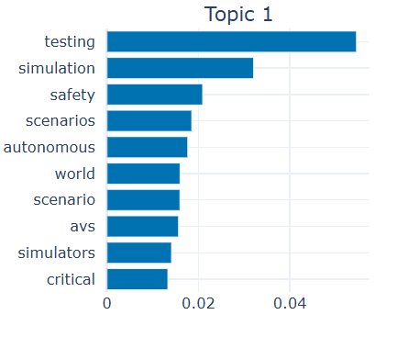
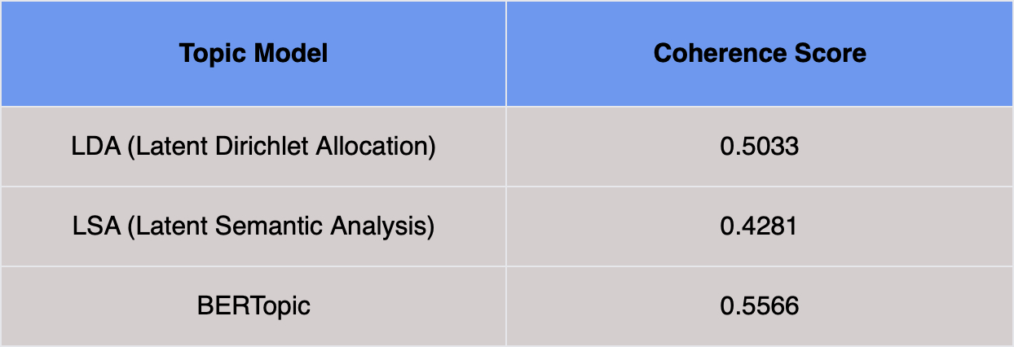
Results
6. Performance Comparison
5. Topics generated by BERTopic
Notes:
What Pic?

Slide 16
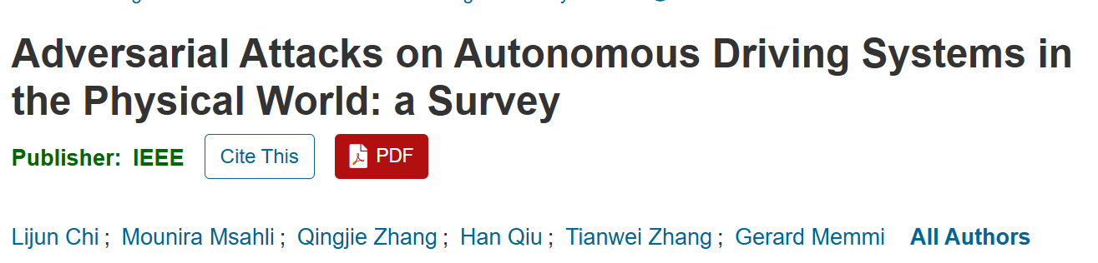
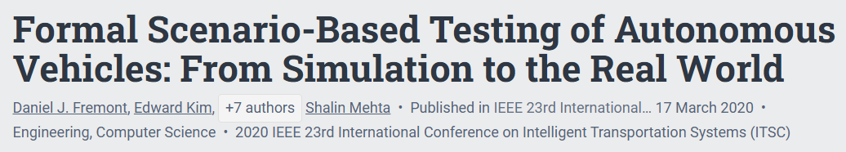
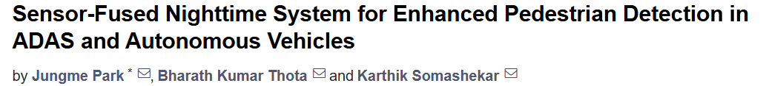

Results
7. Human evaluation of the topics
Notes:
What Pic?

Slide 17
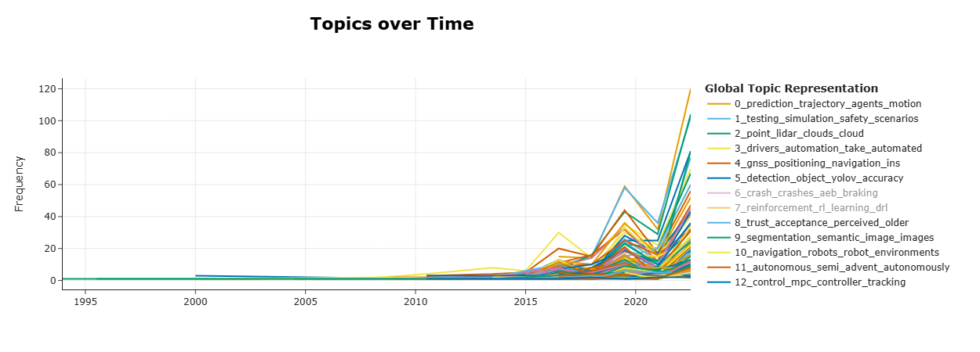
Results
8. Graph showing Topics over Time
Notes:
Is this made based on topics over time chart?

Slide 18
Results
Temporal Analysis:
The evolution of research focus areas over time was analyzed using temporal trends. The time series plot illustrates the progression of various research topics in autonomous vehicles over time.
1. Early Years (1995–2010):
Minimal activity is observed in research publications during this period.
Topics like GNSS Positioning and Trajectory Prediction show occasional interest, indicating foundational work on navigation and motion planning.
2. Growth Period (2010–2015):
A gradual increase in research is seen, particularly in topics like Testing and Simulation and LIDAR Point Cloud Processing.
This period marks the rise of key technologies required for autonomous systems, such as object detection and mapping.
Notes:
Is this made based on topics over time chart?

Slide 19
Results
3. Expansion Period (2016–2019):
A noticeable surge in research activity occurs, with prominent growth in topics such as Driver Automation Systems, Safety and Crash Analysis - Indicating increased focus on ensuring system reliability and reducing risks. Emerging themes include Reinforcement Learning and Semantic Image Segmentation, driven by the integration of machine learning techniques.
4. Recent Surge (2020–2024):
A sharp spike in publication volumes across nearly all topics is evident, reflecting the rapid technological advancements and growing interest in autonomous vehicles.
Dominant topics: Control and Trajectory Planning, Testing and Safety, Advanced Learning Techniques, Trust and Ethics, Fleet Management and Autonomy, Navigation in Robotics, Object Detection
Notes:
Is this made based on topics over time chart?

Slide 20
Challenges & Limitations
Data Annotation Challenges
Since the dataset contains academic papers without labeled data for relevance
While annotating using Llama3 is done, but it can be improved using GPT4 which needs funding
Topic Model Relevance
Although using algorithms like LDA, LSA, and BERTopic can help extract topics from large datasets, the topics generated may not always align with the true focus areas of the research.
Topic modeling is sensitive to hyperparameters, and minor adjustments may cause a shift in results, leading to less relevant topics
Data Quality and Duplication
Removing duplicates based on title and author can help clean the dataset, but it may still leave underlying issues with data quality.
For example, papers from different conferences or journals might contain overlapping research, making it difficult to determine the exact progression of topics

Slide 21
Conclusion & Future Work
Key Observations:
The highest publication volumes are observed in recent years, emphasizing the maturation of the autonomous vehicle field.
The rise in diverse topics like Edge Computing, Real-Time Decision-Making (BERTopic nuances), and Cybersecurity highlights the multidisciplinary nature of current research.
Foundational areas like Perception Systems (Sensors and LIDAR) appear to plateau, reflecting a shift toward application-driven research and societal integration.
Future Work:
Incorporating Multimodal Data: Future work could explore integrating additional data sources, such as patent filings, industry reports, and news articles, alongside academic papers.
Leveraging more advanced natural language processing models for semantic understanding could improve the extraction of relevant research topics, ensuring more accurate insights into the shifting landscape of autonomous driving research.

Slide 22
References
[1] Zhang, Qingyang, et al. Multimodal Fusion on Low-quality Data: A Comprehensive Survey. This paper focuses on challenges like incomplete and imbalanced data and highlights solutions for improving prediction accuracy using multimodal fusion techniques in autonomous driving.
[2] Alexander G. Schwing et al. Monocular 3D Object Detection and Orientation Estimation with Confidence. IEEE/CVF Conference on Computer Vision and Pattern Recognition (CVPR). This study focuses on enhancing 3D object detection by leveraging monocular images and providing confidence scores.
[3] Henrik I. Christensen et al. Towards Safe Autonomous Systems: Future Directions in Regulatory and Ethical Frameworks. Journal of Artificial Intelligence Research (JAIR). Explores the interplay of technological advancements, societal acceptance, and regulatory frameworks necessary for widespread deployment of autonomous vehicles.
[4] L. Chi et al., "Adversarial Attacks on Autonomous Driving Systems in the Physical World: a Survey," in IEEE Transactions on Intelligent Vehicles.
[5] M. Hussain and J. -E. Hong, "Evaluating and Improving Adversarial Robustness of Deep Learning Models for Intelligent Vehicle Safety," in IEEE Transactions on Reliability
[6] Park, J., Thota, B. K., & Somashekar, K. (2024). Sensor-fused nighttime system for enhanced pedestrian detection in ADAS and autonomous vehicles. Sensors (Basel, Switzerland), 24(14), 4755.

Slide 23
Other Resources
Corpus after basic preprocessing
Final Corpus after annotating using Llama3
Keywords.docx
Github Link for Code
S.No. | Name | Contribution
1. | Teja Mandaloju | Team Lead, Coding, Documentation
2. | Hema Reddy Yanala | Coding, Presentation & Documentation
3. | Lavanya Nidamanuri | Primary Documentation
4. | Vijaya Kumari | Coding & Documentation
5. | Kavya Likitha | Documentation
6. | Chaitanya Priyanka | Documentation
Team contribution Table

Slide 24
Thank you! Question?

